Slide 1
Cybersecurity for Future Presidents
Lecture 8:
How can individuals be associated with
actions in a computer (and when should they be)?
What would conducting public elections by computer require?

Slide 2
Any Questions?
My office hours:
Wed. afternoon, 12-3pm, 442 RH
About previous lecture?
About homework?
About reading? D is for Digital, Part III, Communications, introduction and Chapter 8, pp. 117-134 (Networking).
Homework for next week:
Debate readings on Canvas
Supplementary for today’s lecture: Chapter 2, “Authentication in the Abstract,” pp. 33-54, in Authentication through the Lens of Privacy, NRC report. – in Supplementary readings file on Canvas
Problem set, debate prep; see Canvas

Slide 3
Cybersecurity events from the past week of interest to future (or current) Presidents:
Utah Republican caucus used online voting yesterday
“$80,000 contact to London-based SmartMatic, which has set up online voting in the small country of Estonia.”
http://www.smartmatic.com/
FBI backs off legal confrontation with Apple (for now)
Maybe found another way in to the iPhone in question
Android “Stagefright” exploit announced, can defeat ASLR protections on devices with patch level prior to Oct 15, 2015; hardware-specific attack required
Attack details here:
https://www.exploit-db.com/docs/39527.pdf
Lithuanian “elves” counter apparently mercenary pro-Russian trolls on social websites
Coming up: … ?

Slide 4
The lecture on one slide How can individuals be associated with actions in a computer?
1. Accountability: being able to hold someone responsible for an action.
Why it’s important:
can provide incentives for corrective actions that otherwise won’t exist
When you may not require it
2. Fundamental technical issues, trusted path
3. Identification: a claim of who you are: userID, token?
Identity for a context
4. Authentication: verification of the claim.
5. Authorization: decision to allow entity to perform some restricted function
6. Forensics: providing accountability after the fact
7. What are the requirements for voting systems for public elections with secret ballots?

Slide 5
Why is accountability important for cybersecurity?
Accountability provides a basis for accepting risk, for example in business transaction:
Amazon will do business with you if you can be held accountable for things you order (i.e., your credit card is valid)
You will do business with Amazon if you can hold them accountable for delivering what you order and standing behind it
Security-critical operations need to be performed on behalf of an authorized individual
Software installation / update
Enrolling / removing users
Installing certificates
Etc.
Note that not all operations need to be individually accountable
Web browsing from a public library: need to have a library card but need not be individually identified
Barbed wire and trespassing

Slide 6
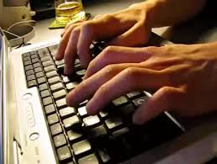
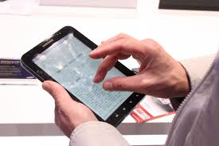
Context for Establishing Accountability in Human-Computer Interaction
How does the system know whose fingers are on the keyboard?
When we type in a password, how do we know where it goes?
?

Slide 7
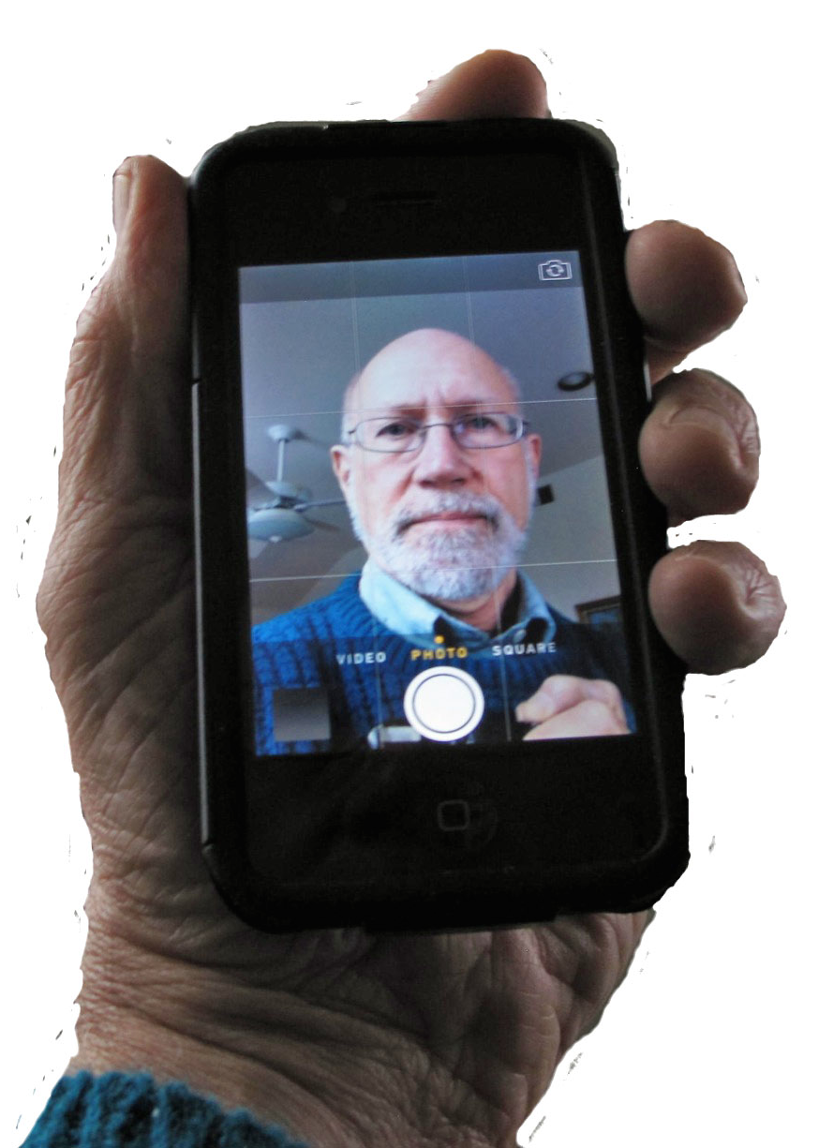
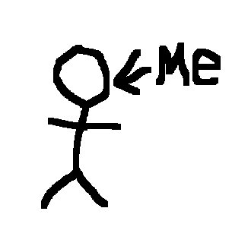
Fundamental Technical Issues
Identifying the user
Self declaration
Observation
Trusted Path
How to be sure you are not being spoofed by the computer
How the computer can be sure you are not spoofing it
Degrees of authentication
Authentication for “normal use”
Authentication for critical acts (installing software, adding/removing users, changing permissions
Authentication over time
Smartphone observing its owner

Slide 8
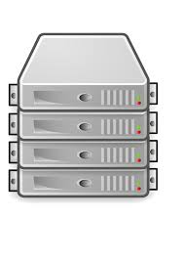
Trusted* Path mechanisms
Trusted path
Trusted Path: mechanism that provides confidence that the user is communicating with what the user intended to communicate with, ensuring that attackers can't intercept or modify whatever information is being communicated <Wikipedia>
Original intent: prevent malware from spoofing security labels
“secure attention key” allows user to cause a hardware interrupt, assuring “Trusted Computing Base (TCB)” gets control
Modern equivalent: Windows: Ctl-Alt-Delete, MacOS: Apple-Opt-Esc, iPad, iPhone: the button at the bottom of the screen
Virtual Private Networks (VPNs) use encryption to provide trusted path through network
Problem: today’s “TCB” is often the whole operating system

Slide 9
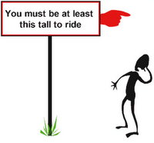
What is Identification?
How do you identify yourself?
Talking to a human:
“Hi, I’m <insert name>”
It’s an assertion that you are (who you say you are)
If you are meeting in person, normally you can see each other
If you are speaking over the phone, your voice may be recognizable
If you are “talking” to a computer:
For a typical laptop, identity = user ID
Also for a website (bank, store) also a user ID (which is often also an e-mail address
If identity = user ID then nearly all of us maintain multiple identities
What if your are talking to a smartphone or tablet? A “smart” appliance?
An identified individual may have attributes (age, height, etc.); sometimes only these attributes and not full identity are needed for authorization

Slide 10
What is Authentication?
Authentication is the process of establishing confidence that you are the person (or identity) you claim to be
Three parties to authentication: presenter, issuer, verifier
Presenter provides credential from issuer to verifier
At a hotel desk or airport: providing a driver’s license, passport, etc. (OK, these documents are referred to as “ID’s” – but we will consider them authenticators)
For a computer, typically it’s a password, could be a fingerprint
Windows 10 to accept fingerprint, iris, face biometric (March 2015)
For a smartphone/tablet: usually a PIN, could be a fingerprint
Without authentication, is confidentiality possible?

Slide 11
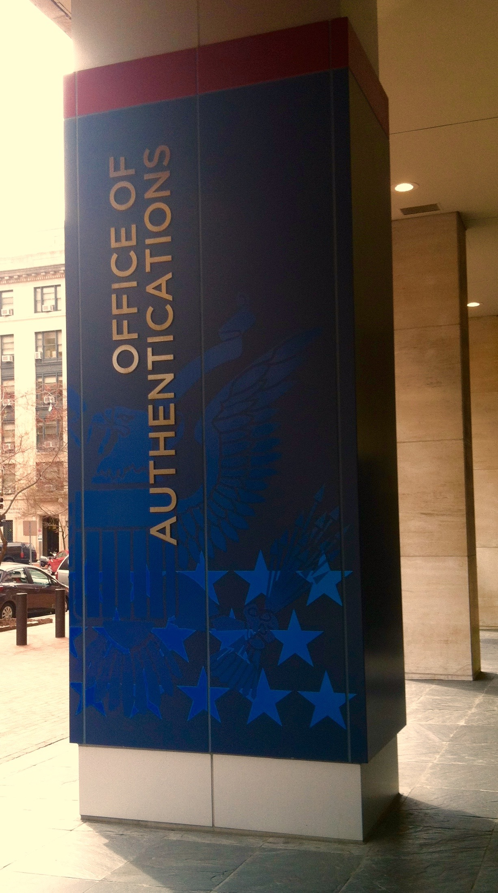
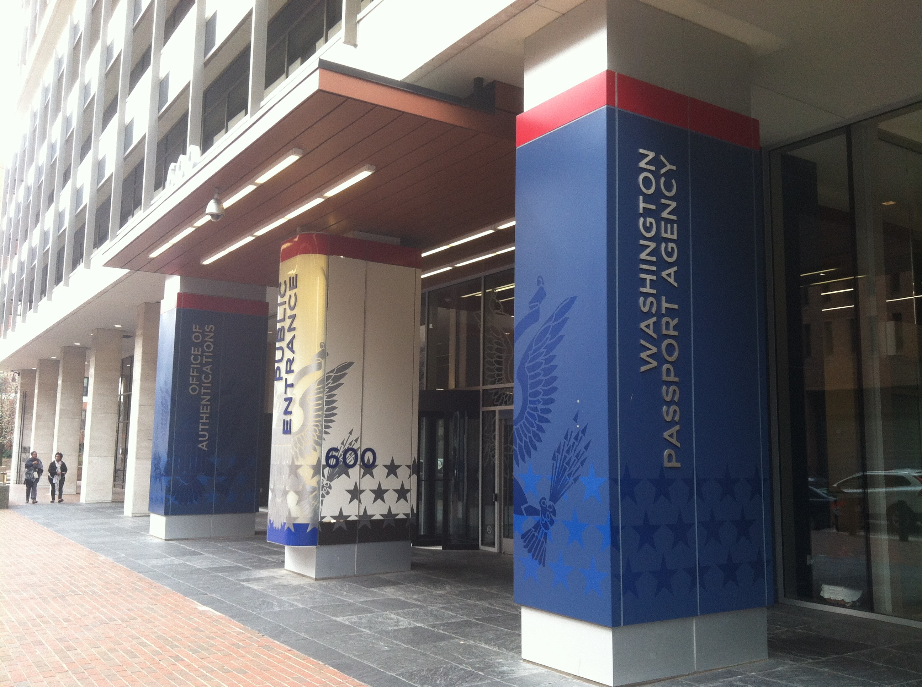
Sidebar: State Dept. Has Dept. of Authentications!
(for documents, not people) Provides assurance to foreign countries that U.S. documents (e.g., diploma, birth certificate, business incorporation) are legally correct (i.e., that the notarizations on them are valid)

Slide 12
Aspects of Authentication
Degrees of authentication
You might provide more or less evidence, for example
work ID < driver’s license < passport < birth certificate
Multi-factor authentication
Something you know: password
Something you have: token
Something you are: biometric
Discrete vs Continuous authentication
Mutual authentication: assuring this is the device (website) you think it is, and the website assuring you are the person you claim to be
CAPTCHA*s: to prove to a machine the claim you are human
*Completely Automated Public Turing test to tell Computers and Humans Apart

Slide 13
What kind of authentication is appropriate?
Policy decisions are made about authorization and accountability
When deciding on authentication behavior, require only what is needed for the planned use
Identify and perform individual authentication
Retrieve attributes needed for authorization
Perform authorization
Keep a record of individual and action
Policy requires accountability?
yes
Policy requires authorization based on individual ID or attribute?
Identify and perform individual authentication
Retrieve attributes needed for authorization
Perform authorization
Do not keep a record of individual and action
yes
Policy requires authorization based on nonidentifying attribute?
Do not identify
Perform attribute authentication
Perform authorization
Do not keep a record of individual and action
yes
no
Do not identify, authenticate, or keep record
Taken from Fig. 2.1, p. 35, Who Goes There? Authentication Through the Lens of Privacy, NRC CSTB http://www.nap.edu/catalog/10656.html

Slide 14
Knowledge-based authentication (“Something you know”) -- 1
Things not widely known (“security questions” – not secrets):
Could be one or more questions for you to answer (e.g., mother’s maiden name, your high school, pet’s name, etc.). More questions might boost confidence of authentication
Convenient – you don’t have to remember anything special (except the answers you gave the system when you enrolled)
Vulnerable – if attackers can discover this information about you (e.g. on Facebook, LinkedIn, etc.)
Also, each time you reveal one some system now knows it
OK for not-too-important services; not suitable for high assurance situation (e.g. bank withdrawal)

Slide 15
Knowledge-based authentication (“Something you know”) -- 2
Secrets
A PIN, password, passphrase
Terrible: password should be hard to guess, easy to remember, not written down, regularly changed, … (??!!)
But useful: can key it into any system, can share it (then change it!)
Calculating the size of the password space
Imposing constraints on passwords: characters vs words
Oxford English Dictionary (OED): 6.15*10⁵ words.
# random 10 character strings: 26¹⁰ = 1.4*10¹⁴
But (6.15*10⁵)⁴ = 1.4*10²³ -- so four words is much bigger space than 10 characters, and probably easier to remember
Storing passwords so they can’t easily be stolen (one-way functions again)
Passwords for website logins

Slide 16
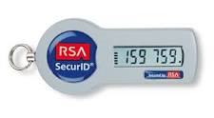
Token-based authentication (“Something you have”)
Car keys: active or passive
One-time password tokens (or lists)
RSA SecurID
Mobile phone as a token (w/texts for codes)
IP address of your computer? (not really useful, because it changes)
MAC (Media Access Control) address of your computer’s network interface (this is built in to the network interface card (NIC) on your computer and is unique to that card)
Cookie on your computer: once you are authenticated, server may store a cookie on your machine that it can request on the next visit. This may be used to authenticate you and your machine. Not so good on a public computer (e.g. library, lab).

Slide 17
Biometrics (“Something you are”)
Note: biometrics are NOT secrets!
Even though you may think of them that way, you leave them everywhere: fingerprints, facial image, iris, DNA, etc.
How are biometrics stored in a computer?
In general, features are extracted during enrollment
Template constructed from extracted features is stored
During authentication, biometric is re-sensed, features extracted, and features compared with those in the stored template
Note the importance of Trusted Path between user/sensor and authentication software
“Close enough” → match. False positive, false negative is possible
Difference between confirming identity (this input matches the claimed identity) and determining identity: here’s an input, who is it?
What if a biometric database (e.g. template store) is stolen?
Do you need to change your fingerprints/iris/face? [no]
Can someone spoof your identity with the stolen information?[maybe a little easier, but Trusted Path is an important protection
Do your biometrics become useless for identification?

Slide 18
Authorization
Authorization: assuring that rules concerning how some (computing) resource may be used are obeyed
Who can read this message?
Who can post to this website?
Who can install software on this machine?
Why we have I&A: you want to perform some actions that are authorized for your claimed identity
Sometimes, authorization may not require authentication, if full accountability is not needed, as noted in the flow chart earlier
“Must be at least 4’ tall to ride the roller-coaster”
Sometimes, accountability can be provided even though identification is not: deposit for billiard balls, for example

Slide 19
Forensics: accountability after the fact
“Forensic” having to do with argument (debates are forensics) but particularly legal argument, arguments in court
In the context of this lecture, trying to establish accountability for some criminal act or act of war, after the fact
Computer forensics
Trace evidence in computers
Network forensics
Evidence from network traffic or network infrastructure
Relationship to side channels: often forensic evidence is provided by analysis of digital breadcrumbs the perpetrator may be unaware of
May lead investigators deeply into implementation details
How much evidence do you need for criminal attribution?
How do we know who was behind the Sony attacks?
How is all this affected by the fact that bots are so easy to obtain?

Slide 20
Some types of forensic evidence
Files found on a hard drive
How did the file get there? → whose fingers were on the keyboard?
Files that the user may have deleted, but weren’t overwritten
Data remaining in bits of disk drive that have been discarded by the drive
Data in backup files (local or remote)
Data in temporary files or RAM
Network data
Network traffic logs on client
Server records of traffic
Router logs
What if some or all of the data are encrypted?
Can the accused be legally coerced to supply the encryption key?
It depends: at a border crossing, probably so
In a criminal investigation, if the prosecution can show probable cause

Slide 21
Attribution
Attribution: regard something as being caused by someone (or something); ascribing a work to a particular author, artist, speaker
Attack attribution is often a difficult issue to resolve in cybersecurity, because of a general lack of accountability: it’s hard to know
Whether a particular machine with a particular IP address was used wittingly or unwittingly as a source of attack or storage
Whose fingers were on the keyboard when an attack occurred
Who might have provided incentives to the individual whose fingers were on the keyboard?
Evidence sometimes used to support attribution
System logs showing evidence of malware infestation (or not)
External observation of actual computer use (e.g. video surveillance)
Internal observation of computer use (via keylogger, e.g.)

Slide 22
National Identity Systems – policy and practice
Other countries
US
History
Government record systems
Citizen concerns
Medical records
National Strategy for Trusted Identities in Cyberspace
RealID (state drivers license) program
Passports

Slide 23
Public Policy Requirements for Voting in Public Elections
Establish eligibility to vote in election
Assure vote is cast as voter intends
Assure the cast vote can’t be mapped back to the voter (beyond what vote totals may tell)
Provide assurance to voter that her/his vote was counted correctly
Prevent vote buying, vote fraud
Auditable process in case of trouble

Slide 24
Security Engineering view of a system
Policy
What you are supposed to enforce/achieve
Incentives
Both for protectors and attackers
Mechanism
Technical means for enforcing policy
Assurance
What confidence do we have in individual mechanisms?

Slide 25
Security Engineering view of public elections
Policy
Authorized Voters
Accurate/auditable count
Anonymous votes
No vote buying/coercion
Incentives
Protectors: Assure policy upheld
Attackers:
Control outcome
Deny service
Mechanism(s) (conventional)
Registration lists
Paper ballot
Voting booth
Sealed ballot boxes
2-party public counting
<Alternative voting: early, absentee, mail-in>
Assurance
What confidence do we have
In individual mechanisms?
In overall results?

Slide 26
Security Engineering view of public elections
Policy
Authorized Voters
Accurate/auditable count
Anonymous votes
No vote buying/coercion
Incentives
Protectors: Assure policy upheld
Attackers:
Control outcome
Deny service
Mechanism(s) (Internet/Electronic)
Computerized Reg. Lists
Electronic ballot
Open computer
Database for counting
2-party administration
Assurance
What confidence do we have
In individual mechanisms?
In overall results?

Slide 27
Cryptographic Methods Useful in Elections
Cryptographic Checksums
To permit detection of changes to data (e.g., ballots, but also software components)
Secret sharing
To permit decryption keys to be split into pieces (like the pieces of a treasure map)
(k,n) threshold cryptography: n shares, k<n needed to reconstruct key
Think of a polynomial of degree n: need n points on the curve to reconstruct it
Give each party a subs
Secure Multiparty Computation
Simple example (compute average weight)

Slide 28
Public Policy Some U.S. Election History
U.S. adoption of secret (“Australian”) ballot after 1884 Presidential election, requiring
Government printed ballot with all nominees, parties, issues
Distributed only at polling place
Marked in secret
Note that mail-in ballots (and absentee ballots, depending) violate 2 & 3, yet Washington and Oregon conduct all elections this way.
U.S. election administration is generally local; elections are run by states, counties, precincts
2000 election problems in Florida prompted Congress to pass Help America Vote Act (HAVA) of 2002 with aims
Replace punch-card and lever voting machines
Create the Election Assistance Commission
Establish minimum election administration standards
Funded with $3B appropriation for states to purchase new equipment satisfying
Permit the voter to verify ballot selections
Provide the voter the ability to change/correct ballot before casting
Notify voter of any over-votes and permit corrections

Slide 29
Public Policy HAVA consequences
Boom in electronic voting equipment marketplace
Funding bubble provoked one-shot products rather than long term stable development
Decentralized purchasing (many states, municipalities) meant many inexperienced groups making decisions
Systems put in place without adequate security vetting
Various studies, initiatives, exposed vulnerabilities in these systems
Some states now turning to paper-based systems (for auditability) with scanners (for checking valid ballots and counting)

Slide 30
(Potential) Roles for Cryptography in Voting Systems
Encryption
Secrecy of ballot
Digital signatures
Integrity of ballot
Secret sharing
Enforce “2-man rules”
Vote verification
Schemes for voter to verify that vote is counted

Slide 31
Public Policy Alternative Voting in the US
Early Voting
Absentee Voting
Mail Voting

Slide 32
Role of Access Control in Voting Systems
Roles:
Voter
Identification/authentication
Registration checker
Election judge/administrator
Vote tallying

Slide 33
How would you manipulate / defraud such a system?
What does the security/integrity of the system depend upon?
Software
Hardware
Procedures

Slide 34
Backup/Callout slides follow

Slide 35
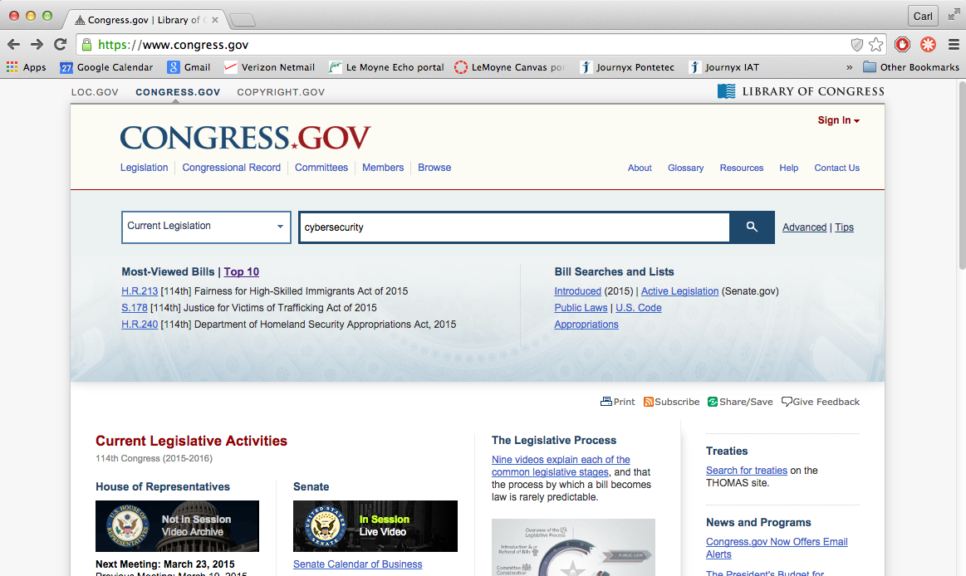
Find Draft legislation

Slide 36
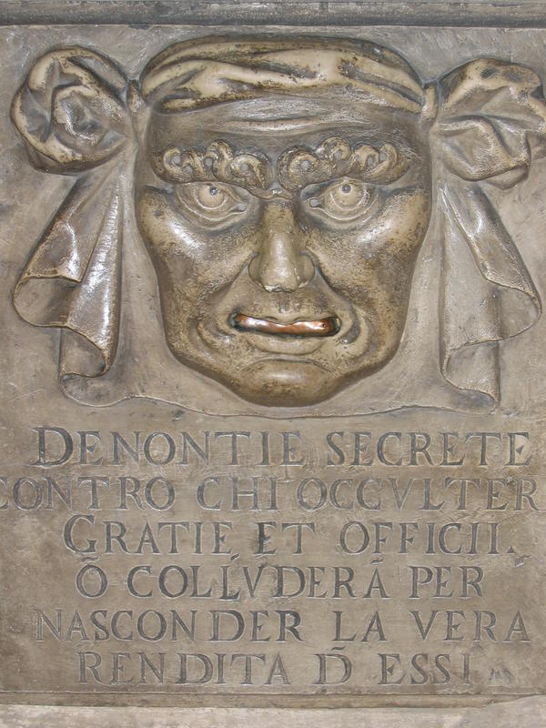
Anonymity in Venice
Secret denunciations against anyone who will conceal favors and services or will collude to hide the true revenue from them.

Slide 37
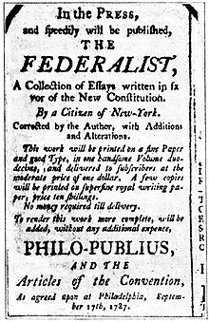
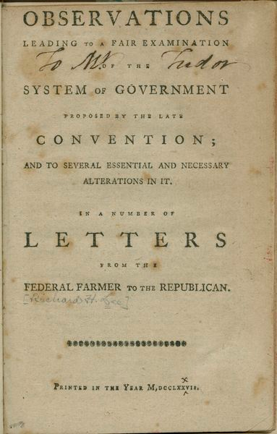
Federalist Papers, 1787
Alexander Hamilton, James Madison, John Jay wrote under the pseudonym “Publius” arguments in favor of adopting the Constitution
“Federal Farmer” published the same year with opposing arguments; authorship still uncertain

Slide 38
Accountability and Anonymity
Accountability:
Ability to be called to account, take responsibility
Butler Lampson’s definition re spam
Forensics as a form of accountability
Anonymity
Ability not to be identified with some action
Pseudonymity (Federalist papers, e.g.)
Participation in experimental trials
Re-identification

Slide 39
A brief personal history of Onion Routing
Original goal: provide a way for Navy to use the Internet for communications without being vulnerable to traffic analysis
Idea: create an overlay network – a network that is layered on top of the Internet
Break data into uniform chunks, super-encrypt it, and ship it around this overlay network, changing its encryption at each node so that
packets coming into a node can’t be correlated with packets leaving that node later on
The destination of the packet is only known to the initiating node and the final recipient
Other traffic obscures the Navy’s traffic
Data only in the clear when it reaches destination host
Weakness: the fact that web browsing needs to happen in real time means that some kinds of timing attacks are hard to avoid entirely
Nevertheless, this is about as good as it gets today for providing anonymous communication on the Internet
And there are two sides to that, as with many things

Slide 40
Connection Setup
B
C
F
A
D
E
Proxy
Core Onion Router
The initial proxy knows the Onion Routing network topology, selects a route, and generates the onion
Each layer of the onion identifies the next hop in the route and contains the cryptographic keys to be used at that node.

Slide 41
Data Movement
As data moves through the anonymous connection, it looks different at each onion router.
A message M sent from an initiator to a responder via a 5-hop onion route will change as follows:
The initiator pre-crypts M giving: E(E(E(E(E(M)))))
Entering A, the message will look like: E(E(E(E(E(M)))))
Entering D, the message will look like: E(E(E(E(M))))
Entering B, the message will look like: E(E(E(M)))
Entering C, the message will look like: E(E(M))
Entering F, the message will look like: E(M)
The responder receives: M
M
Initiator
√
A
D
B
C
F
Responder
M
M
M
M
M
M

Slide 42
What happened
Prototypes developed and demonstrated (late 1990s)
One of the inventors (Syverson) pushes to open source the technology (late 1990’s to early 2000’s)
Continues to push for full scale development
Additional funding and personnel located to continue the development
Deployment of full scale technology (2005+, I think)
Picked up by State Department as enabling dissent, free speech
Picked up by criminals as enabling cloaking of illegal markets (Silk Road)

Slide 43
Surveillance and Privacy
Surveillance is another way to provide accountability
May be other purposes as well – e.g. public safety
Kinds of surveillance
Public (physical) spaces
Private spaces (need a warrant; requires “probable cause finding”)
Cyberspace: also could be public and private
Wiretap (monitoring phone call content) requires warrant
“Pen register” information: number called, duration (not content) generally does not (“metadata”)
Much policy debate and more to come
What about government monitoring of public facebook pages, for example?
Should storing of captured data in encrypted form be considered “collection”?

Slide 44
Anonymity - Background
The ability to hide one’s identity
Much like the inverse of accountability: the ability to speak or act without being held to account
It has a long history:
Venice under the Doges
Federalist papers in America before the Constitution, 1787
Supreme court ruling in McIntyre v. Ohio, 1995 (declared unconstitutional an Ohio law requiring disclosure of identity on campaign literature):
“Protections for anonymous speech are vital to democratic discourse. Allowing dissenters to shield their identities frees them to express critical minority views . . . Anonymity is a shield from the tyranny of the majority. . . . It thus exemplifies the purpose behind the Bill of Rights and of the First Amendment in particular: to protect unpopular individuals from retaliation . . . at the hand of an intolerant society.
<2015 Lecture concluded here>

Slide 45
Degrees of anonymity
Anonymity can be relative
Pseudonym – maps individual to some other identifier
Who holds the link?
Identity as a group member
How large is the group?
How is membership determined/validated?
Anonymity with respect to whom?
For communication, you may reveal your identity to your correspondent, but you may want to be anonymous to anyone eavesdropping on network traffic

